Slide 1



UNIT 2
Achievements
Part 1

Slide 2
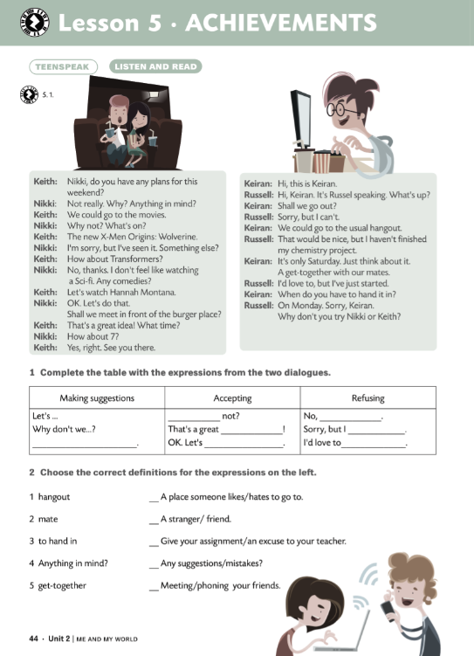
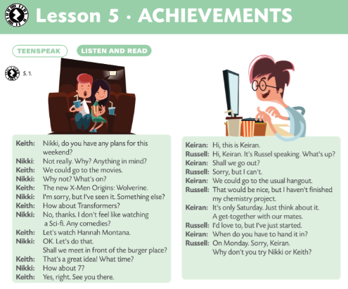


What do you do in your free time?
Do you often go to the cinema? Who with? Which day of the week is the day when you have a get-together with your mates?
Do you have a usual hang out? What is it? Where is it?
How and when do you decide where to go?

Slide 3

1 Keith would like to go to the cinema.
2 He has already seen X-Men Origins: Wolverine.
3 Nikki would like to see a sci-fi film.
4 Hannah Montana is a comedy.
5 They decide to see Transformers.
1 Keiran would like Russell to...
2 Russell has just started his ...
3 He has to hand it in ...
T
go out with her.
F
chemistry project.
F
T
on Monday.
F
feel like doing something hang out
a get-together with your mates hand in
What’s up? Anything in mind?

Slide 4
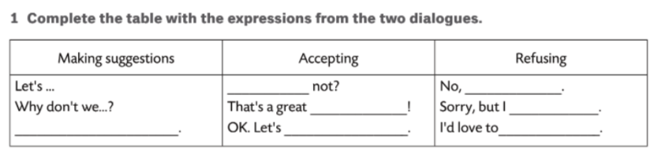
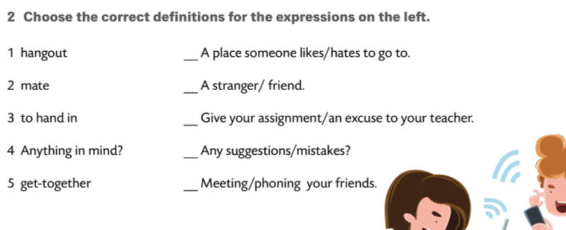
Why
thanks
idea
can’t
Shall we …?
do that
but I’ve just started.

Slide 5
Produce a dialogue of your own, using the expressions given in the book or simply change some of the information in the dialogues.
Act out the dialogues.
Danny, a schoolboy
Tessa, a student
Nigel, scientist
Pam, teacher

